Slide 1
Al-Driven Public Health Chatbot for Disease Awareness
CSE7302- Capstone Project Review-1
Batch Number: CSG_16 Under the Supervision of,
Mr. Asif Ahmad Najar
Assistant Professor
School of Computer Science and Engineering Presidency University
Name of the Program: CSG Name of the HoD: Dr . Pallavi
Name of the Program Project Coordinator: Ms Benitha Christinal J
Name of the School Project Coordinators: Dr. Sampath A K , Dr. Geetha A
Roll Number | Student Name
20221CSG0027 | SUZAIN PATEL
20221CSG0055 | ZAKIR AHMAD
20221CSG0022 | TARUN PANDIAN M
20221CSG0020 S Mohammed Affan
20221CSG0059 Karthik Mp
20221CSG0092 Chaithra C

Slide 2
Problem Statement Number: PSCS_049
Organization: Government of Odisha
Category (Hardware / Software / Both) : Software
Problem Description:
This project proposes the design and development of an AI-powered public health chatbot aimed at educating rural and semi-urban populations about preventive healthcare, common disease symptoms, and vaccination schedules. The chatbot will be accessible via WhatsApp and SMS, ensuring inclusivity for users with limited smartphone or internet access.
The system integrates Natural Language Processing (NLP) techniques with government health databases to deliver accurate, verified, and real-time health information. It also supports outbreak alert notifications at the district or regional level to enable early awareness and preventive action. The solution is designed to be scalable, privacy-aware, and aligned with public health goals of the Government of Odisha.

Slide 3
Content
Problem Statement
Objectives
Background and Related work for title Selection
Analysis of Problem Statement
Proposed Methodology
Innovation or Novel Contributions
GitHub Link
Timeline of the Project
References

Slide 4
Problem Statement
Limited Healthcare Awareness: Rural and semi-urban populations often lack access to accurate and timely information about preventive healthcare, disease symptoms, and vaccinations.
Accessibility Barriers: Most existing digital health platforms fail to operate on low-bandwidth channels like SMS, limiting reach and usability.
Misinformation & Delayed Action: The spread of unverified health information leads to panic, improper self-medication, and delayed medical consultation.
Inefficient Outbreak Communication: Current systems do not provide real-time, localized alerts for disease outbreaks directly to citizens.
Unaddressed Gap: There is no unified AI-based system that can educate, alert, and guide citizens through commonly used platforms such as WhatsApp or SMS.

Slide 5
Objectives
Enable Preventive Healthcare Awareness: Educate users about disease symptoms, prevention methods, and when to seek medical help.
Vaccination Awareness & Scheduling: Provide information on vaccination schedules for children, adults, and seasonal diseases.
Real-Time Outbreak Alerts: Integrate government health data to notify users about regional disease outbreaks.
Accessible Deployment: Deploy the chatbot on WhatsApp or SMS to ensure reach across varying levels of digital access.

Slide 6
Background and Related work for title Selection
Public Health Information Landscape: Governments and health organizations have introduced digital portals, helplines, and awareness programs to disseminate information on diseases, vaccinations, and preventive care. However, these systems are mostly static and require users to actively search for information.
Existing Digital Health Chatbots: Prior research and existing chatbot solutions focus primarily on appointment booking, symptom checking, or urban-centric healthcare services, often lacking regional or cultural adaptation.
Limitations of Current Approaches: Most existing systems fail to operate on low-bandwidth channels like SMS, and lack integration with real-time government health surveillance data.
Research and Implementation Gap: Despite the availability of verified health data, there is no unified conversational system that can proactively educate users, deliver vaccination guidance, and issue real-time outbreak alerts tailored to specific regions and populations.
Identified Research Gap: Existing studies focus on general healthcare chatbots or urban-centric solutions, whereas limited work addresses preventive public health awareness for rural and semi-urban populations.

Slide 7
Analysis of Problem Statement
Healthcare Information Accessibility Issues: A significant portion of rural and semi-urban populations lacks easy access to reliable and understandable healthcare information.
Prevalence of Health Misinformation: Unverified health content circulated through informal channels often leads to panic, delayed treatment, or unsafe self-medication.
Delayed Disease Awareness & Response: Current systems fail to provide localized, real-time alerts during disease outbreaks, reducing preventive preparedness.
Technology Opportunity & Gap: The widespread availability of mobile phones creates an opportunity for AI-based conversational systems, yet such solutions are not adequately leveraged for public health awareness.

Slide 8
Proposed Methodology
User Interaction Layer: Users interact with the system through WhatsApp
Natural Language Processing (NLP): User inputs are processed using NLP techniques for intent detection and entity extraction to understand the health-related query.
Dialogue Management System:
A conversational flow engine manages context, user intent, and dialogue state to generate meaningful responses.
Health Knowledge & Government Data Integration: The system retrieves verified information from curated health knowledge bases and government health datasets, including vaccination schedules and outbreak data.
Response Generation & Delivery:
The chatbot generates easy-to-understand, non-diagnostic responses and delivers them back to users through WhatsApp or SMS.

Slide 9
Innovation or Novel Contributions
Unified Health Awareness Platform: Combines disease education, vaccination guidance, and outbreak alerts in one chatbot
WhatsApp or SMS Integration:
Ensures accessibility for both smartphone and feature-phone users.
Government Data Integration:
Uses verified health databases to ensure trustworthy and up-to-date information.
Integrated Preventive Public Health Framework:
Encourages early awareness and responsible healthcare behavior without replacing professionals, Unlike existing systems that address isolated healthcare functions, the proposed approach unifies health education, vaccination guidance, and real-time outbreak alerts into a single conversational system.

Slide 10
Github Link
https://github.com/Stu-Affan/Medical-Chatbot

Slide 11
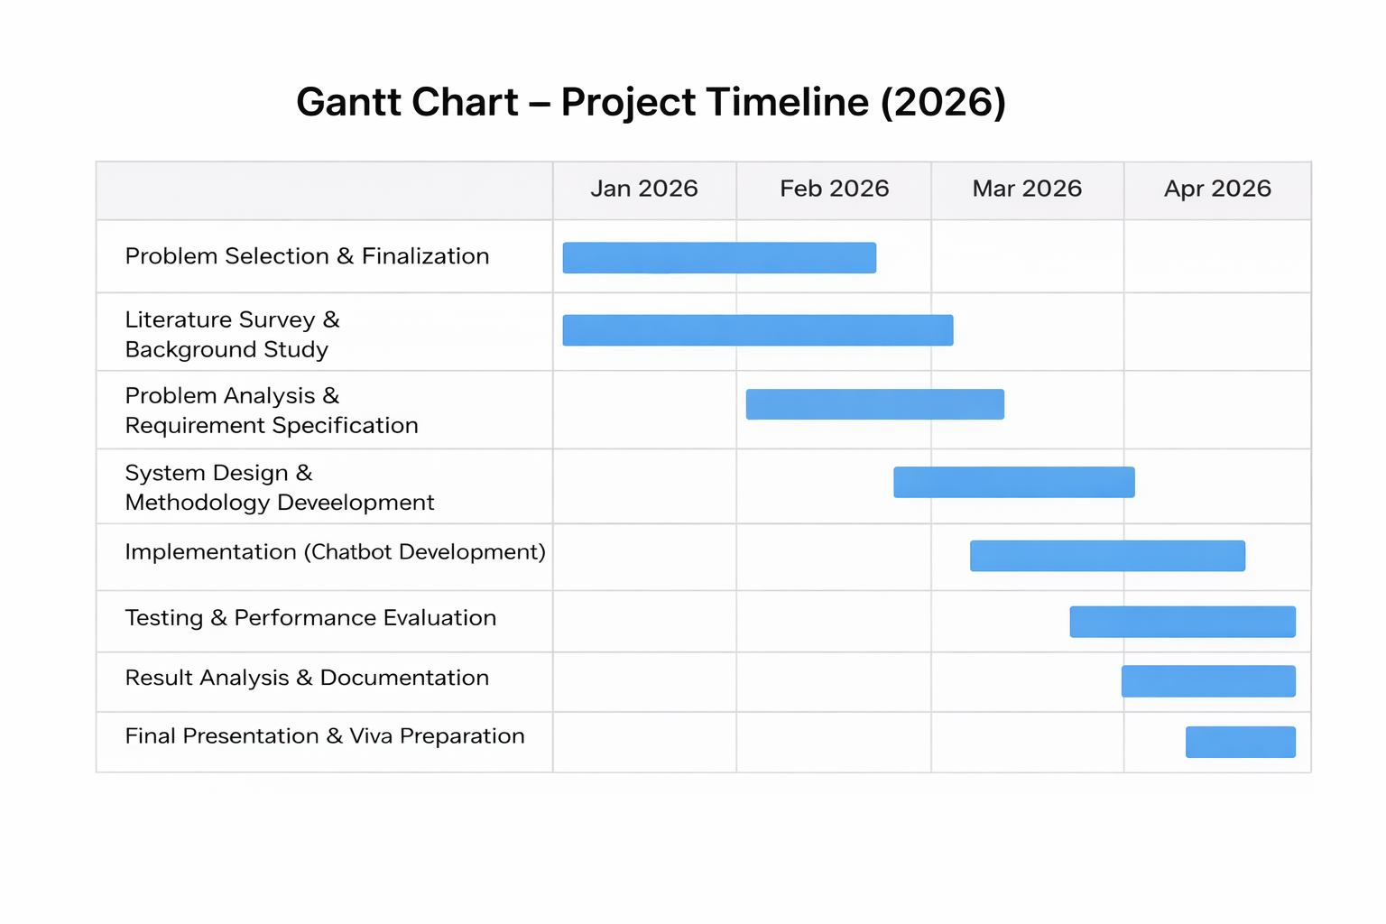
Timeline of the Project

Slide 12
REFERENCES
[1] Laranjo, L., Dunn, A.G., Tong, H.L., Kocaballi, A.B., Chen, J., Bashir, R., Surian, D., Gallego, B., Magrabi, F., Lau, A.Y.S. and Coiera, E., 2018. Conversational agents in healthcare: A systematic review. Journal of the American Medical Informatics Association, 25(9), pp.1248–1258.
[2]Bickmore, T.W., Trinh, H., Asadi, R. and Olafsson, S., 2018. Safety first: Conversational agents for health information. Journal of Biomedical Informatics, 82, pp.1–9.
[3]Wilson, L. and Marasoiu, M., 2022. The development and use of chatbots in public health: Scoping review. JMIR Human Factors, 9(4), e35882.
[4]Branda F, Stella M, Ceccarelli C, Cabitza F, Ceccarelli G, Maruotti A, Ciccozzi M, Scarpa F. The Role of AI-Based Chatbots in Public Health Emergencies: A Narrative Review. Future Internet. 2025; 17(4):145. https://doi.org/10.3390/fi17040145
[5]Singhal, K., Tu, T., Gottweis, J., Sayres, R., Wulczyn, E., Hou, L., Clark, K., Pfohl, S., Cole-Lewis, H., Neal, D., Schaekermann, M., Wang, A., Amin, M., Seneviratne, S., Wu, Z., Aratow, M., Prabhakaran, D., Gao, S., Narayan, R., and Corrado, G., 2023. Large language models encode clinical knowledge. Nature, 620, pp.172–180.

Slide 13


